Slide 1

Exploring Spatial Data with sf
Sheila Saia
Thursday, February 7, 2019
BAE 590
@sheilasaia
ssaia@ncsu.edu

Slide 2
Please fill out a pre-workshop survey!
https://goo.gl/forms/17Xs1IbhAkXIyeIw1
Notes:
(5 min)

Slide 3
Workshop Materials
You can find the workshop materials on GitHub:
https://github.com/sheilasaia/sf-workshop-bae590
You will need to download the data for the workshop too. See green download button on repo website? Once downloaded, see workshop_data > README.md for the link.
Notes:
(5 min, end 10 min total)

Slide 4
Just a few questions…
How many people have been using R for < 1 year, 1 year, 2 + years? (sit down when it no longer applies)
Shout out some of your favorite R packages.
How many of you have heard of the sf package?
What is an R package?
Notes:
(3 min, end 13 min total)

Slide 5
Workshop Learning Outcomes
By the end of this workshop you will be able to:
1. Describe what the sf package is and how to use it
2. Explain some different types of sf spatial operations
3. Apply sf operations to a real-world geospatial dataset
Notes:
(2 min, end 15 min total)

Slide 6
What is (geo) spatial data?
maps
lat and long
location
relative to position on Earth (maybe other planets)
Notes:
(2 min, end 17 min total)
Data that describes the spatial distribution of something/someone on Earth (or any planet really), has coordinates and geometric shape (= topology, CRS)

Slide 7
Major Types of Spatial Data
1. Vector data – points, line, polygons, scalable graphics
2. Raster data – pixels (grid), unit on grid represents attribute
Can you think of examples of each?
Can you think of example file extensions for each?
Notes:
(1 min on own, 2 min with partner, 5 min with class, end 25 min total)
vector - way to represent spatial features using points, lines, and polygons (e.g., gps points, bus route, lot parcel, park boundary), .shp files
raster - way to represent points spatial features using grid where each cell has one value that represents some attribute (e.g., elevation, land cover type, inches of rainfall), .img files

Slide 8
What is sf?
sf stands for simple features, it’s an R package
Use it for vector spatial operations & plotting
Package was first published May 2018 (pretty new!)
Was developed to replace the sp package, which didn’t meet all ISO simple features standards
works well with the tidyverse! - dplyr, ggplot, etc.)
More info here: https://github.com/r-spatial/sf
Notes:
(2 min, end 27 min total)

Slide 9

Class Dataset: USGS GAGES-II
“...Geospatial Attributes of Gages for Evaluating Streamflow, version II, provides geospatial data and classifications for 9,322 stream gages maintained by the U.S. Geological Survey (USGS)”
Available online at:
https://water.usgs.gov/GIS/metadata/usgswrd/XML/gagesII_Sept2011.xml
*We will also use some TIGER data...see README in the GitHub repository for more info.
Notes:
(2 min, end 29 min total)

Slide 10
USGS GAGES-II Dataset (continued)
Includes:
Watershed boundaries by region (reference and non-reference, spatial data)
USGS gage locations (spatial data)
Watershed characteristics (tabular data)
Notes:
(1 min, end 30 min total)

Slide 11
What is a coordinate reference system (CRS)?
Notes:
(2 min, end 32 min total)
A CRS is a specific type of projection (aka a way of translating a 3D image to 2D).

Slide 12
What is a coordinate reference system (CRS)?
Image credit & for more info see: https://bit.ly/2DJzTby
Notes:
(1 min, end 33 min total)
figure showing three major families of projections

Slide 13
What is a coordinate reference system (CRS)?
sf has two ways to define a CRS:
1. proj4 string – a character string with CRS info
2. EPSG code – standard code that defines a projection type, see here: http://epsg.io
Notes:
(1 min, end 34 min total)
we’ll look at each of these when we open Rstudio

Slide 14
A VERY important note about CRSs…
Always make sure to check that the spatial data you’re using has the same CRS. If not, you’ll need to project them all to the same one before doing any analysis.
A cute dog to get your attention! >
Be sure to check & project!
Notes:
(1 min, end 35 min total)

Slide 15
Activity 1: Getting Started with sf
Open up sf-workshop-bae590.Rproj
Install sf and load libraries (if you haven’t already)
Load in the spatial data using st_read( )
Use class( ) and glimpse () to view one of the files you loaded in
Check CRS using st_crs( )
Can you find the proj4 and EPSG codes?
Notes:
(5 min to do this, 5 min to discuss what they liked, didn’t like, had trouble with, was easy, end 45 min total)
Maybe you’ve used rgdal package’s readOGR( ) function before this but would have to tell it which values were the coordinates, sf determines this automatically

Slide 16
What might you want to do with these data?
Think about spatial operations that might be helpful to use.
Make a list with your group of 2-3 people (2 min)
Discuss with everyone (3 min)
Ideas:
spatial join
area
interpolation
clipping (intersections)
buffering
Notes:
(5 min, end 50 min total)
Some answers:
Define a coordinate system using st_set_crs( )
Project it to another coordinate system using st_transform( )
Save just the attributes using st_set_geometry = NULL
Find the area using st_area( )
Find the centroid of a polygon using st_centroid( )
Do spatial operations like intersection using st_intersection( ), st_buffer( ), st_union( ), st_merge( ) - some of these I’m not sure how they work
Convert points to lines, lines to polygons, etc. using
Add tabular data (using the joins/the tidyverse!)

Slide 17
Activity 2: Common Operations in sf
Open up sf_workshop_script.R
Let’s try some of the operations we just talked about.
*(For later) Look here for more inspiration: https://cengel.github.io/rspatial/3_spDataOps.nb.html
Notes:
(10 min, end 60 min total)

Slide 18
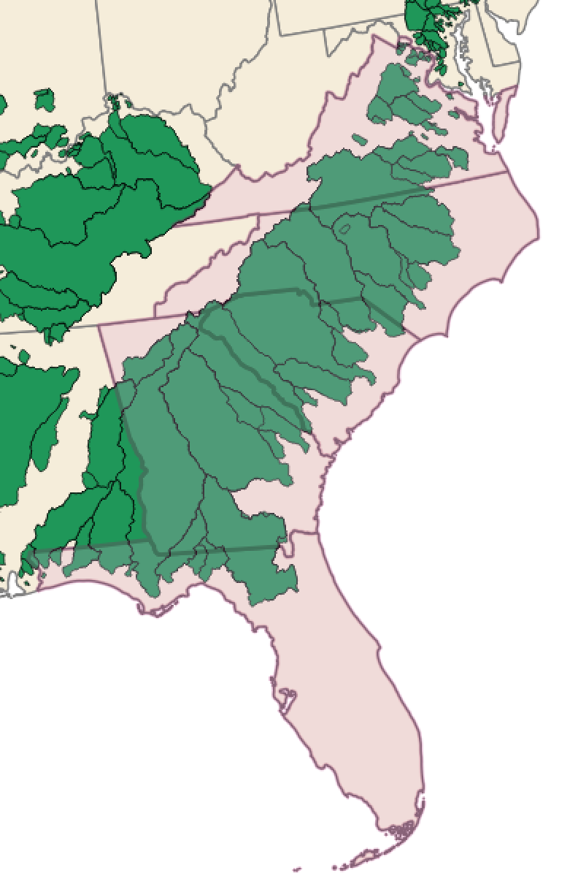
Activity 3: Putting sf to Work with GAGES-II Data
Pick your favorite SE state
(Hint: Make a new variable)
Find all the watersheds that overlap
Plot the watersheds in your favorite
state.
Notes:
(10 min, 70 min total)

Slide 19
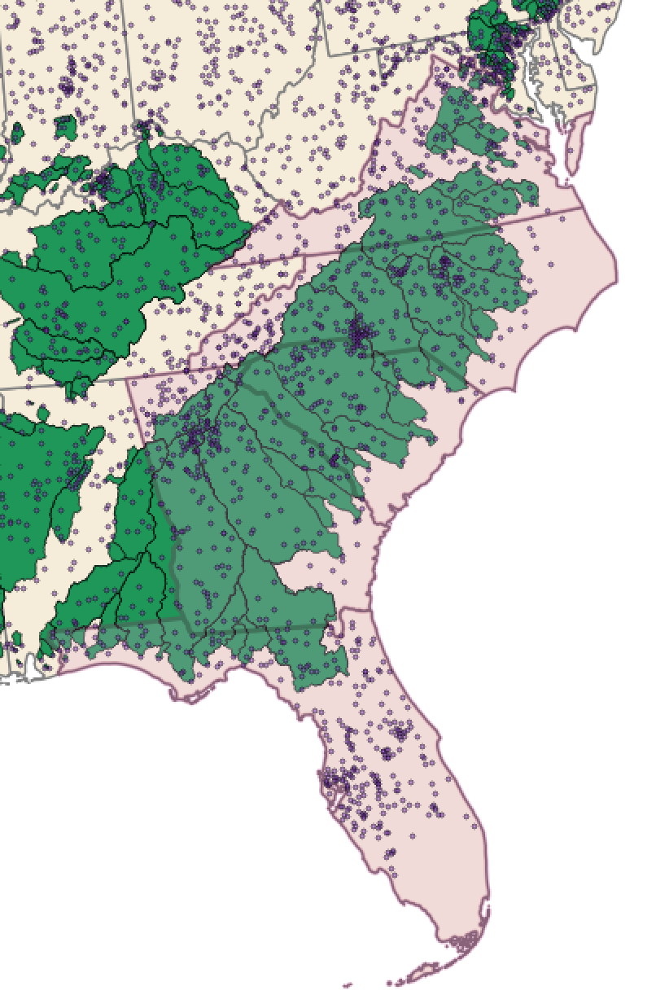
(if time) Activity 4: Bringing in the tidyverse
Use your favorite state (from Activity 3)
Select all the gages in that state
Join some of the tabular data and color
these gages by your favorite variable
(Hint: see the tabular_data file for
GAGES-II variable descriptions)
Extra: Download USGS gage data for
one (or multiple) gage(s) in your state
using the dataRetrieval R package

Slide 20
Workshop Learning Outcomes Revisited
Now that it’s the end of this workshop,
I hope you’re able to:
1. Describe what the sf package is and how to use it
2. Explain some different types of sf spatial operations
3. Apply sf operations to a real-world geospatial dataset

Slide 21
Please fill out a post-workshop survey!
https://goo.gl/forms/17Xs1IbhAkXIyeIw1
Notes:
(last 5 min, end 75 min)

Slide 22
There’s another side! See references slide for link.

Slide 23
Helpful sf Resources
sf cheetsheet: https://github.com/rstudio/cheatsheets/blob/master/sf.pdf
sf vingettes, news, and other resources: https://github.com/r-spatial/s
Spatial Data Sciece with R (book, newer): https://www.rspatial.org/
Applied Spatial Data Analysis with R (book, older)
If you’re using raster data check out the raster package
Other raster data packages: rgdal (but really the raster package is the best)

